Slide 1
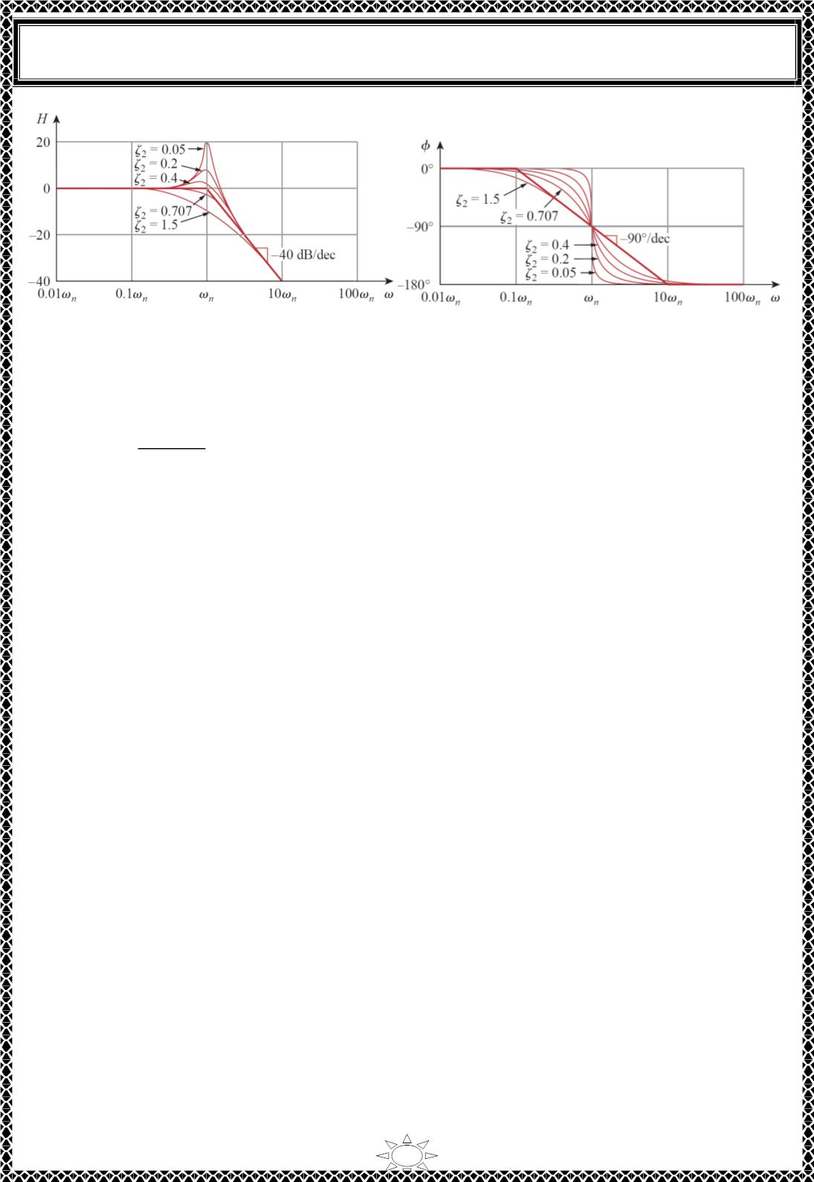
University of Diyala
Engineering College
Electrical Circuits
Fig. 4.4. Bode plots of quadratic pole [1 + 푗2휁휔/휔_{푛} − 휔^{ꢀ/휔푛ꢀ]ꢁꢂ: (푎)} magnitude plot, (b)
phase plot.
The phase can be expressed as
휑 = −tan^{ꢁꢂ}
^{ꢀꢃ}ꢄ^{ꢅ/ꢅ}
ꢂꢁꢅ^{ꢄ}/ꢅ^{ꢄ}
0.
휔 = 0
휔 = 휔_{푛}
ꢆ
= {−90^{표}.
…(4.10)
휔_{푛}/10
ꢆ
−180^{표}. 휔 → ∞
표
The phase plot is a straight line with a slope ꢇ푓 − 90 per decade starting at
and
ending at 10휔_{푛}, as shown in Fig. 4.4. (b). We see again that the difference between the
actual plot and the straight‐line plot is due to the damping factor. Notice that the
straight‐line approximations for both magnitude and phase plots for the quadratic pole are
Trail Version
Trail Version
Trail Version
Trail Version
Trail Version
Trail Version
Trail Version
Trail Version
Trail Version
Trail Version
Trail Version
Trail Version
Trail Version
ꢁꢀ
the same as those for a double pole, i.e. (1 + 푗휔/휔 ) . We should expect this because
푛
^{the double pole (1 + 푗휔/휔}_{푛}⁾ꢁꢀ _{equals the quadratic pole}
1/[1 + 푗2휁 휔/휔 + (푗휔/휔 )ꢀ]
ꢀ
푛
푛
when 휁ꢀ = 1. Thus, the quadratic pole can be treated as a double pole as far as straight‐line
approximation is concerned. For the quadratic zero [1 + 푗2휁 휔/휔 + (푗휔/휔 ) , the
ꢂ
푘
푘
ꢀ]
plots in Fig. 4.4. are inverted because the magnitude plot has a slope of 40 푑퐵/decade
while the phase plot has a slope of 90^{표} per decade.
Table 4.1 presents a summary of Bode plots for the seven factors. Of course, not every
transfer function has all seven factors. To sketch the Bode plots for a function 퐻(휔) in the
form of Eq. (4.4), for example, we first record the corner frequencies on the semilog graph
paper, sketch the factors one at a time as discussed above, and then combine
12

Slide 2
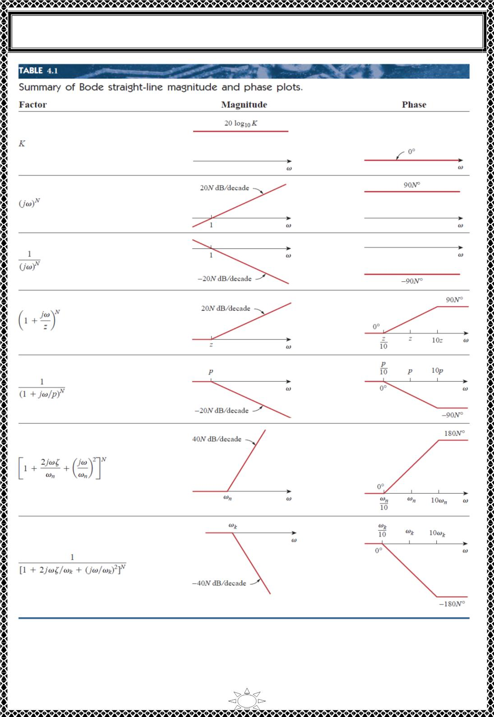
University of Diyala
Engineering College
Electrical Circuits
Trail Version
Trail Version
Trail Version
Trail Version
Trail Version
Trail Version
Trail Version
Trail Version
Trail Version
Trail Version
Trail Version
Trail Version
Trail Version
additively the graphs of the factors. The combined graph is often drawn from left to right,
changing slopes appropriately each time a corner frequency is encountered. The following
examples illustrate this procedure.
13

Slide 3
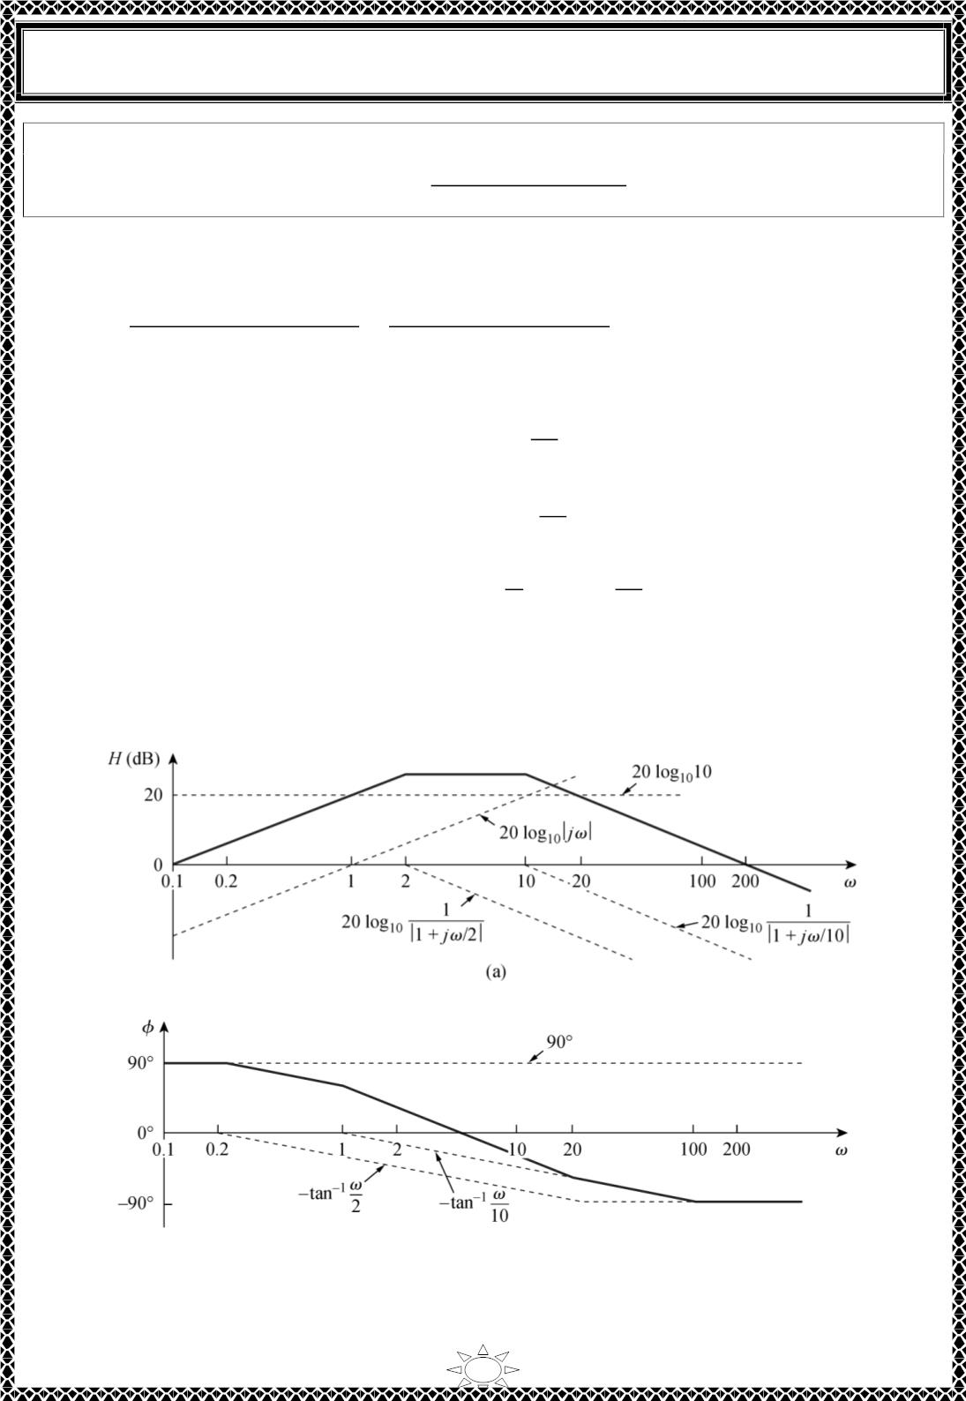
University of Diyala
Engineering College
Electrical Circuits
Example 3: Construct the Bode plots for the transfer function
퐻(휔) =
200푗휔
(푗휔 + 2)(푗휔 + 10)
Solution:
We first put 퐻(휔) in the standard form by dividing out the poles and zeros. Thus,
퐻(휔) =
10푗휔
=
10|푗휔|
∠90^{표} − tanꢀꢁ휔/2 − tanꢀꢁ휔/10
(1 + 푗휔/2)(1 + 푗휔/10) |1 + 푗휔/2||1 + 푗휔/10|
Hence, the magnitude and phase are
푗휔
2
퐻 = 20log 10 + 20log |푗휔| − 20log |1 +
푑퐵
ꢁꢂ
ꢁꢂ
ꢁꢂ
|
−20log_{ꢁꢂ}|1 +
휔
푗휔
|
10
휔
휑 = 90^{표} − tanꢀꢁ − tanꢀꢁ
2
10
Trail Version
Trail Version
Trail Version
Trail Version
Trail Version
Trail Version
Trail Version
Trail Version
Trail Version
Trail Version
Trail Version
Trail Version
Trail Version
We notice that there are two corner frequencies at 휔 = 2.10. For both the magnitude and
phase plots, we sketch each term as shown by the dotted lines in Fig. below. We add them
up graphically to obtain the overall plots shown by the solid curves.
(a) magnitude plot,
(b) phase plot.
14

Slide 4
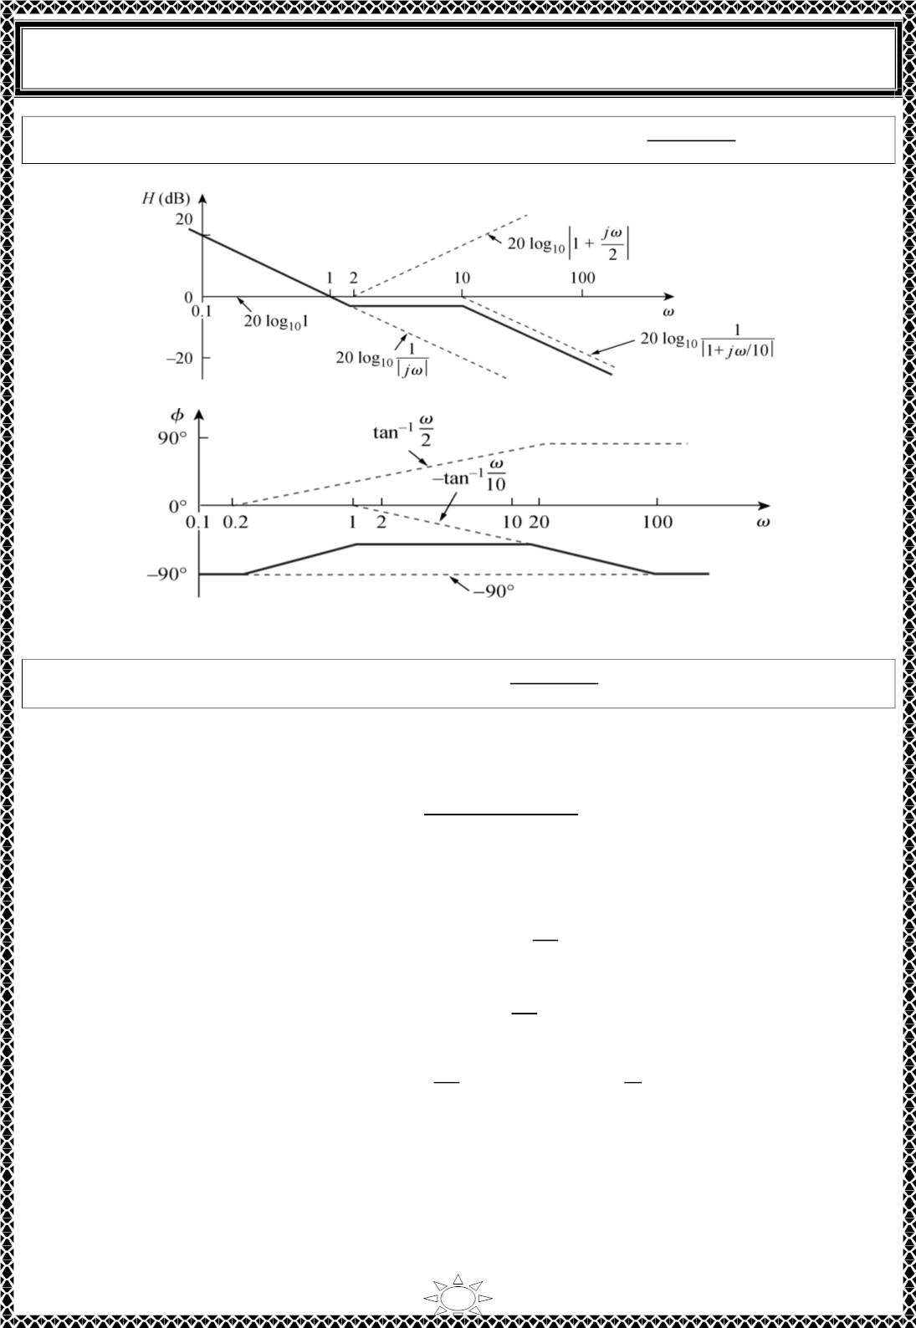
University of Diyala
Engineering College
Electrical Circuits
5(푗ꢀ+2)
H.W.3: Draw the Bode plots for the transfer function 퐻(휔) =
Answer:
푗ꢀ(푗ꢀ+10)
(a) magnitude plot,
Trail Version
Trail Version
Trail Version
Trail Version
Trail Version
Trail Version
Trail Version
Trail Version
Trail Version
Trail Version
Trail Version
Trail Version
Trail Version
(b) phase plot.
푗ꢀ+10
Example 4: Obtain the Bode plots for 퐻(휔) =
푗ꢀ(푗ꢀ+5)ꢁ
Solution:
Putting 퐻(휔) in the standard form, we get
ꢂ.4(ꢃ ꢄ ꢅ휔/ꢃꢂ)
퐻(휔) =
ꢅ휔(ꢃ ꢄ ꢅ휔/ꢆ)²
From this, we obtain the magnitude and phase as
ꢅ휔
퐻 = ꢇꢂlog ꢂ.4 ꢄ ꢇꢂlog |ꢃ ꢄ | − ꢇꢂlog₁₀|ꢅ휔|
푑퐵
10
10
ꢃꢂ
−4ꢂlog₁₀|ꢃ ꢄ
휔
ꢅ휔
|
ꢆ
휑 = ꢂ^{표} ꢄ tan^{ꢈ1}
휔
ꢆ
ꢃꢂ
− 9ꢂ⁰ − ꢇtan^{ꢈ1}
There are two comer frequencies at 휔 = ꢆ.ꢃꢂ푟푎ꢉ/푠. For the pole with corner frequency at
휔 = ꢆ, the slope ofthe magnitude plot is−40 ꢉꢊ/decade and that of the phase plot is −9ꢂ⁰
per decade due to the power of 2. The magnitude and the phase plots for the individual
terms (in dotted lines) and the entire 퐻(ꢅ휔) (in solid lines) are in Fig. below.
15

Slide 5
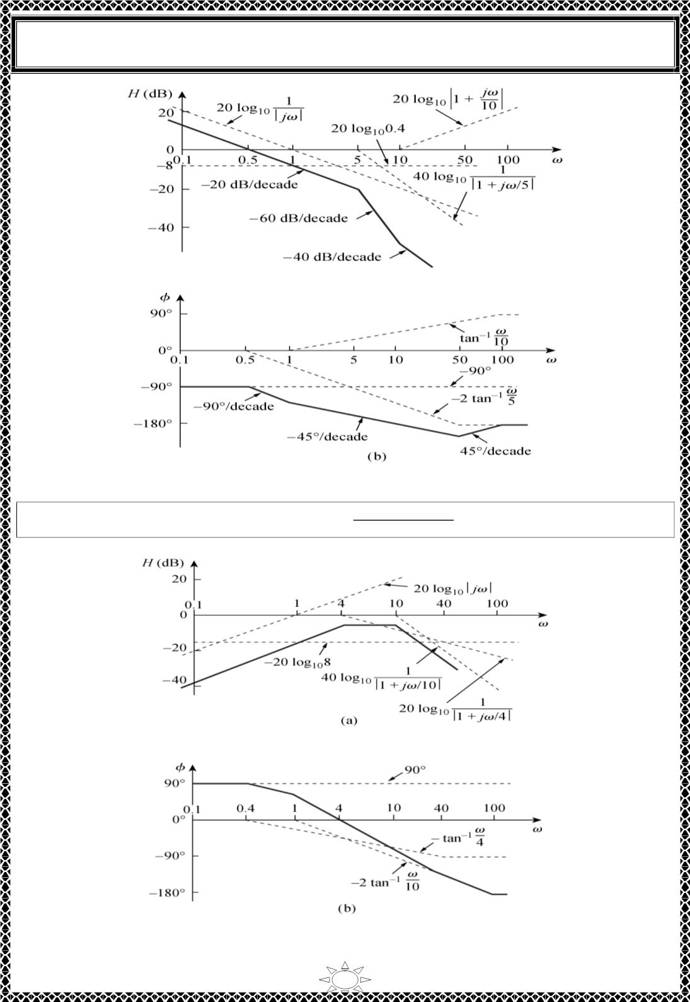
University of Diyala
Engineering College
Electrical Circuits
(a) magnitude plot,
Trail Version
Trail Version
Trail Version
Trail Version
Trail Version
Trail Version
Trail Version
Trail Version
Trail Version
Trail Version
Trail Version
Trail Version
Trail Version
(b) phase plot.
H.W.4: Sketch the Bode plots for 퐻(휔) =
50푗ꢀ
Answer:
(푗ꢀ+4)(푗ꢀ+10)²
(a) magnitude plot,
(b) phase plot.
16

Slide 6
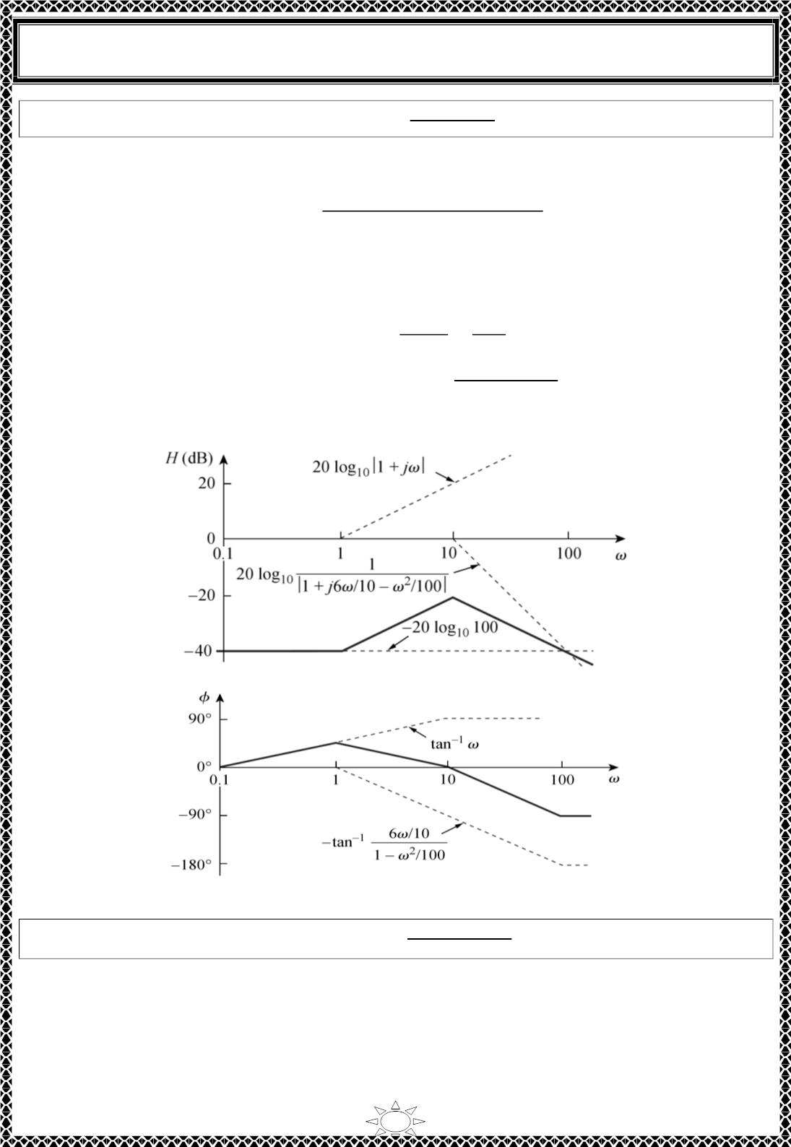
University of Diyala
Engineering College
Electrical Circuits
Example 5: Draw the Bode plots for 퐻(푠) =
ꢀ+1
Solution:
ꢀ²+1ꢁꢀ+100
We express 퐻(푠) as
ꢂ/ꢂꢃꢃ(ꢂ ꢄ 푗휔)
ꢂ ꢄ 푗휔ꢂ.ꢅ/ꢂꢃ ꢄ (푗휔/ꢂꢃ)ꢁ
퐻(휔) =
For the quadratic pole, 휔_{푛} = ꢂꢃ푟푎푑/푠, which serves as the corner frequency. The
magnitude and phase are
퐻_{ꢆ퐵} = −ꢅꢃlog ꢂꢃꢃ ꢄ ꢅꢃlog |ꢂ ꢄ 푗휔|
10
10
−ꢅꢃlog₁₀|ꢂ ꢄ
푗휔ꢂ.ꢅ
ꢂꢃ
휔ꢁ
−
|
ꢂꢃꢃ
휑 = ꢃ^{표} ꢄ tan^{ꢇ1}휔 − tan^{ꢇ1}[
휔ꢂ.ꢅ/ꢂꢃ
]
ꢂ − 휔ꢁ/ꢂꢃꢃ
ꢁ.
푘
Notice that the quadratic pole is treated as a repeated pole at 휔 , that is, (ꢂ ꢄ 푗휔/휔 )
which is an approximation.
푘
Trail Version
Trail Version
Trail Version
Trail Version
Trail Version
Trail Version
Trail Version
Trail Version
Trail Version
Trail Version
Trail Version
Trail Version
Trail Version
(a) magnitude plot,
(b) phase plot.
H.W.5: Construct the Bode plots for 퐻(푠) =
10
Answer:
ꢀ(ꢀ²+80ꢀ+400)
17

Slide 7
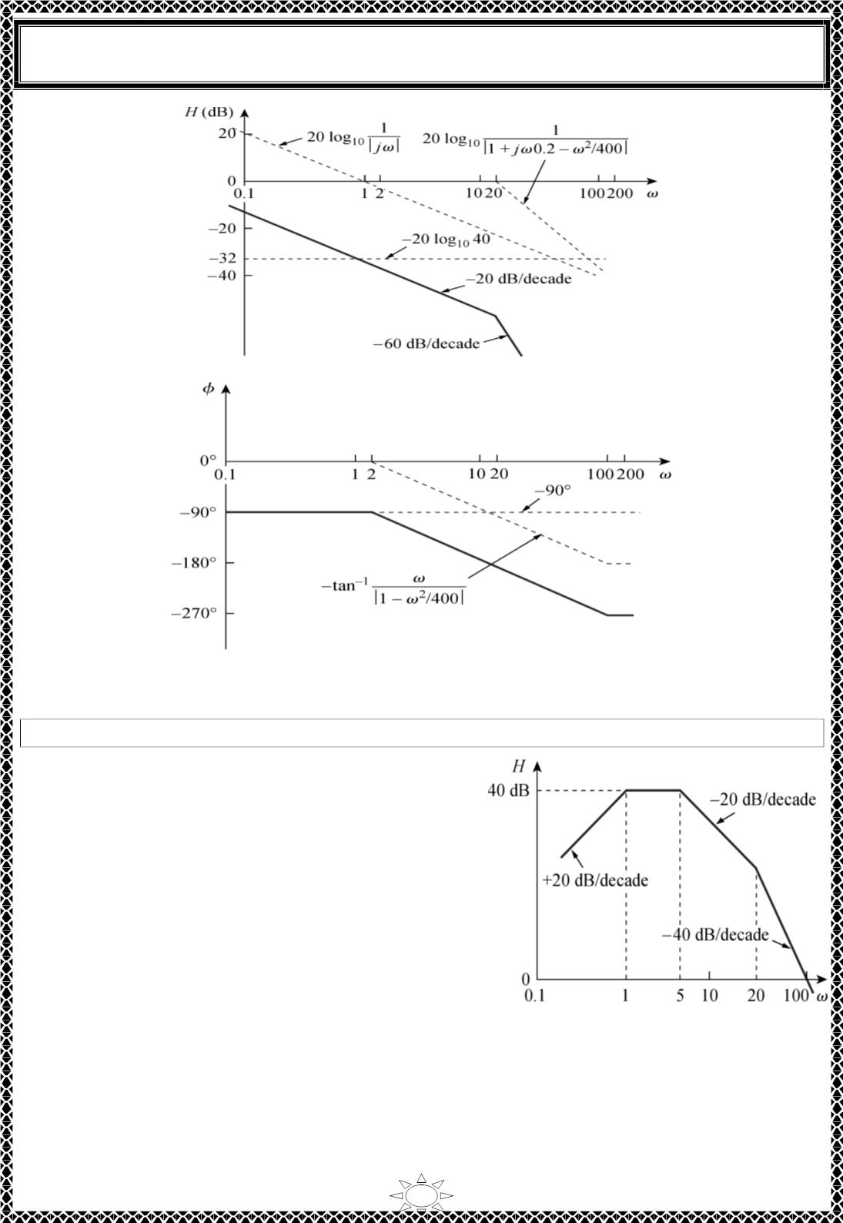
University of Diyala
Engineering College
Electrical Circuits
(a) magnitude plot,
Trail Version
Trail Version
Trail Version
Trail Version
Trail Version
Trail Version
Trail Version
Trail Version
Trail Version
Trail Version
Trail Version
Trail Version
Trail Version
(b) phase plot.
Example 6: Given the Bode plot in Fig. below, obtain the transfer function 퐻(휔) .
Solution:
To obtain 퐻(휔) ffom the Bode plot, we keep in
mind that a zero always causes an upward turn at a
corner frequency, while a pole causes a downward
turn. We notice from Fig. that there is a zero 푗휔 at
the origin which should have intersected the
frequency axis at 휔 = 1. This is indicated by the
straight line with slope +20푑퐵/ decade. The fact
that this straight line is shifted by 40 푑퐵 indicates
that there is a40‐d퐵 gain; that is,
40 = 20log 퐾 ⇒ log 퐾 = 2
or
ꢀꢁ
ꢀꢁ
퐾 = 10^{ꢂ} = 100
18

Slide 8
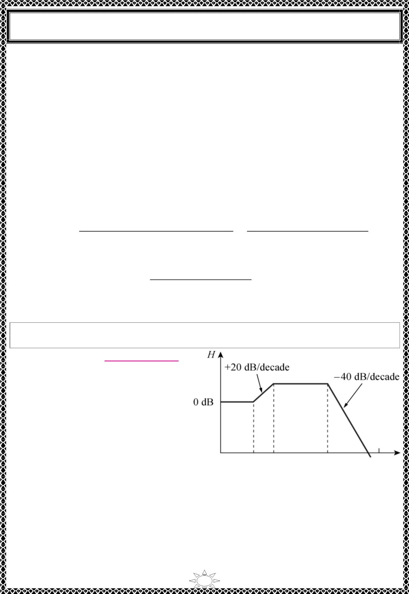
University of Diyala
Engineering College
Electrical Circuits
In addition to the zero 푗휔 at the origin, we notice that there are three factors with corner
frequencies at 휔 = 1 ∙ 5, and 20 푟푎푑/푠. Thus, we have:
1. A pole at 푝 = 1 with slope −20푑퐵/decade to cause a down‐ward turn and counteract
the zero at the origin. The pole at 푝 = 1 is determined as 1/(1 + 푗휔/1) .
2. Another pole at 푝 = 5 with slope −20푑퐵/decade causing a downward turn. The pole is
1/(1 + 푗휔/5) .
3. A third pole at 푝 = 20 with slope −20푑퐵/decade causing a further downward turn. The
pole is 1/(1 + 푗휔/20) .
Putting all these together gives the corresponding transfer function as
퐻(휔) =
100푗휔
=
푗휔10⁴
or
(1 + 푗휔/1)(1 + 푗휔/5)(1 + 푗휔/20) (푗휔 + 1)(푗휔 + 5)(푗휔 + 20)
10^{4푆}
Trail Version
Trail Version
Trail Version
Trail Version
Trail Version
Trail Version
Trail Version
Trail Version
Trail Version
Trail Version
Trail Version
Trail Version
Trail Version
퐻(푠) =
(푠 + 1)(푠 + 5)(푠 + 20)
. 푠 = 푗휔
H.W.6: Obtain the transfer function 퐻(휔) corresponding to the Bode plot in Fig. below
Answer: 푯(흎) =
ퟒ.ퟎퟎퟎ(풔ꢀퟓ)
_{ퟐ}.
(풔ꢀퟏퟎ)(풔ꢀퟏퟎퟎ)
19

Slide 9
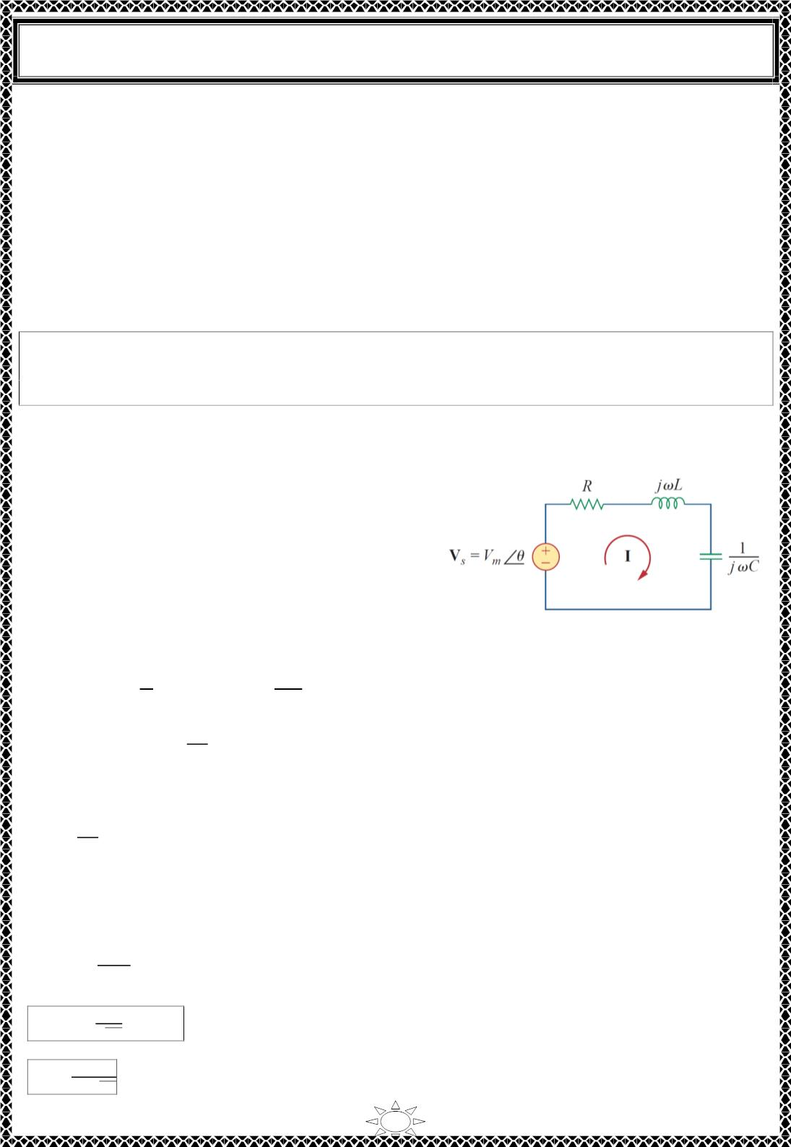
University of Diyala
Engineering College
Electrical Circuits
5) Series Resonance
The most prominent feature of the frequency response of a circuit may be the sharp peak (or
resonant peak) exhibited in its amplitude characteristic. The concept of resonance applies in
several areas of science and engineering. Resonance occurs in any system that has a
complex conjugate pair of poles; it is the cause of oscillations of stored energy from one
form to another. It is the phenomenon that allows frequency discrimination in
communications networks. Resonance occurs in any circuit that has at least one inductor
and one capacitor.
Resonance is a condition in an RLC circuit in which the capacitive and inductive
reactances are equal in magnitude, thereby resulting in a purely resistive
impedance.
Resonant circuits (series or parallel) are useful for constructing filters, as their transfer
functions can be highly frequency selective.
They are used in many applications such as
selecting the desired stations in radio and 푇푉
receivers.
Trail Version
Trail Version
Trail Version
Trail Version
Trail Version
Trail Version
Trail Version
Trail Version
Trail Version
Trail Version
Trail Version
Trail Version
Trail Version
Consider the series RLC circuit shown in Fig.
5.1 in the frequency domain. The input
impedance is
Fig. 5.1 The series resonant circuit.
ꢀ
1
푠
푍 = 퐻(휔) =
= 푅 + 푗휔퐿 +
…(5.1)
퐼
ꢁꢂ퐶
1
∴ 푍 = 푅 + 푗(휔퐿 −
)
…(5.2)
ꢂ퐶
Resonance results when the imaginary part of the transfer function is zero, or
1
휔퐿 −
= 0
…(5.3)
ꢂ퐶
The value of 휔 that satisfies this condition is called the resonant frequency 흎_{ퟎ}. Thus, the
resonance condition is
휔_{ꢃ}퐿 =
1
…(5.4)
ꢂ 퐶
ꢄ
1
∴ 휔_{ꢃ} =
푟푎푑/ꢆ
…(5.5)
…(5.6)
√ꢅ퐶
푓_{ꢃ} =
1
Hz
2휋√ꢅ퐶
20

Slide 10
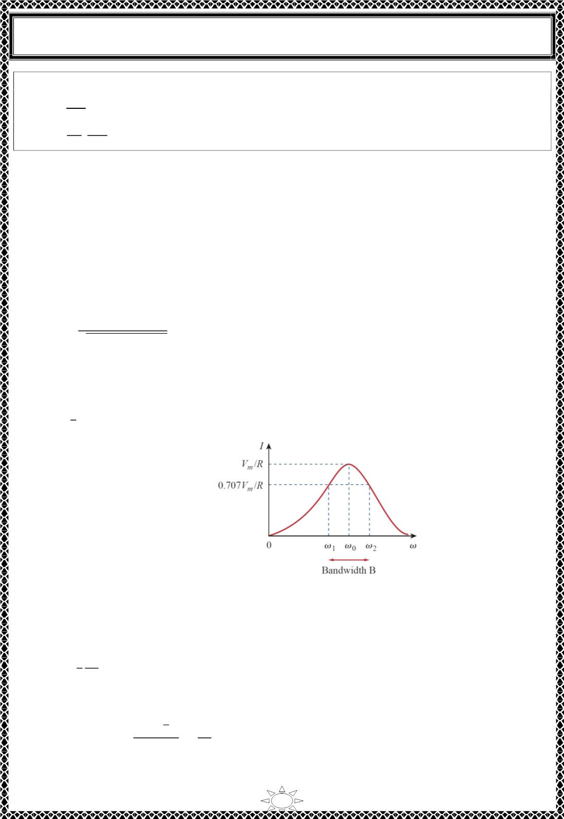
University of Diyala
Engineering College
Electrical Circuits
Notes:
^{푽}풎
|푽_{푳}| =
|푽_{푪}| =
푹
흎_{ퟎ}푳 = 푸푽_{풎}
푽
ퟏ
풎
= 푸푽_{풎}, where Q is the quality factor.
푹
흎_{ퟎ}푪
Note that at resonance:
1. The impedance is purely resistive, thus, 푍 = 푅. In other words, the LC series
combination acts like a short circuit, and the entire voltage is across R.
2. The voltage 푉_{푠} and the current I are in phase, so that the power factor is unity.
3. The magnitude of the transfer function 퐻(휔) = 푍(휔) is minimum.
4. The inductor voltage and capacitor voltage can be much more than the source voltage.
ꢀ
퐼 = |퐼| =
푚
…(5.7)
√ꢁ²+(ꢂ퐿−1/ꢂ퐶)²
The frequency response of the circuit’s current magnitude is shown in Fig. 5.2. The
average power dissipated by the RLC circuit is
Trail Version
Trail Version
Trail Version
Trail Version
Trail Version
Trail Version
Trail Version
Trail Version
Trail Version
Trail Version
Trail Version
Trail Version
Trail Version
1
푃(휔) = 퐼^{ꢃ}푅
…(5.8)
ꢃ
Fig. 5.2 The current amplitude versus frequency for the series resonant circuit of Fig. 5.1
The highest power dissipated occurs at resonance, when 퐼 = 푉_{ꢄ}/푅, so that
2
1 ꢀ
푃(휔₀) =
푚
…(5.9)
ꢃ ꢁ
At certain frequencies 휔 = 휔 . 휔 , the dissipated power is half the maximum value; that is,
1
ꢃ
(ꢀ /ꢅꢃ)²
2
푚
ꢀ
푃(휔 ) = 푃(휔 ) =
푚
1
ꢃ
ꢃꢁ
=
…(5.10)
4ꢁ
Hence, 휔 and 휔 are called the half‐power frequencies.
1
ꢃ
21

